Slide 1

DROWSY DRIVER
DETECTION
presented By :Mohamed Sherif
Mohamed Osama
Ali Zorkany
Yousef el Ghazali

Slide 2

INTRODUCTION
In this project, we developed a drowsy driver detection system using traditional image processing techniques and facial landmark analysis. The system monitors the eyes and mouth in driver images to compute EAR (Eye Aspect Ratio) and MAR (Mouth Aspect Ratio), which are key indicators of drowsiness. This solution runs on a Jupyter Notebook and demonstrates how computer vision techniques can contribute to road safety

Slide 3
TECHNOLOGIES & LIBRARIES
  Python: programming language
  OpenCV: Image enhancement (CLAHE, grayscale) and visualization.
  NumPy: Numerical operations and geometry calculations
  Matplotlib: Displaying processed images in the notebook.
  Pandas: Data handling and analysis
  glob: Reading multiple image files efficiently.
  MediaPipe: Real-time face mesh detection and landmark extraction.

Slide 4
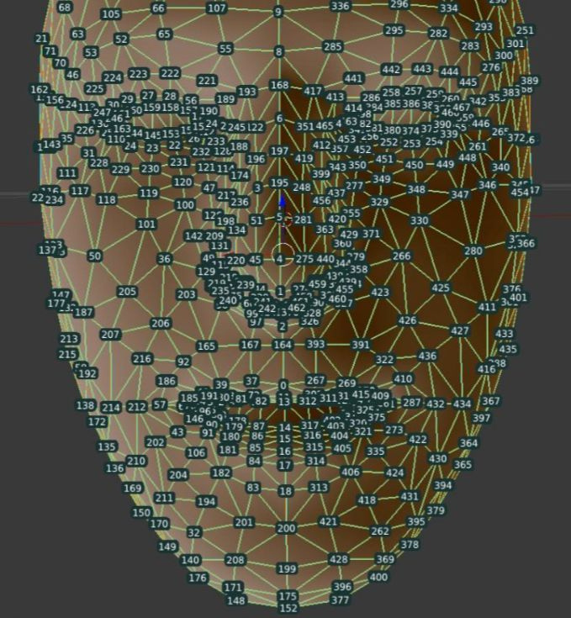
MEDIAPIPE LANDMARKS
What is Mediapipe:
  MediaPipe is an open-source framework by Google that provides real-time face and hand landmark detection
In our project:
  It was used to locate eye and mouth landmarks.
  We used those coordinates to calculate EAR and MAR.

Slide 5
WORKFLOW
  Load image dataset
  Grayscale conversion & brightness-based enhancement
  CLAHE used for dark images.
  Histogram Equalization used for others.
  Detect facial landmarks using MediaPipe
  Calculate EAR & MAR
  Classify as Drowsy or Alert
  Display bounding boxes and labels on images

Slide 6
CHALLENGES & SOLUTIONS
Challenge: - Varying Lighting Conditions
- Landmark Detection Accuracy
Solution:
- Applied CLAHE (Contrast Limited Adaptive Histogram Equalization) to enhance local contrast in grayscale images.
- Used adaptive gamma correction to balance brightness dynamically
- Averaged EAR and MAR over multiple images per person to compute adaptive thresholds for classification.

Slide 7
CONCLUSION
We developed a facial-landmark-based drowsiness detection system using static images.
The system calculated EAR (Eye Aspect Ratio) and MAR (Mouth Aspect Ratio) from facial landmarks to detect closed eyes and yawning.
We improved facial landmark detection using image preprocessing techniques like CLAHE and gamma correction.
For each person, adaptive thresholds were used to improve classification accuracy.
Our approach shows how classical computer vision + MediaPipe can effectively handle offline drowsiness detection, especially in difficult lighting conditions.
This method contributes to driver safety analysis in non-real-time datasets or image logs.

Slide 8
THANK YOU

